Slide 1
1/f Noise Decoupling
Sangyeon Lee
Seoul National Univ.
QDL (Quantum Device LAB. at SNU)
Prof. Eunjong Kim
Date: 2024.02.16

Slide 2
Contents
Theory
Plot (DIM)
Simulation
https://github.com/BrainConnection/QuTiP

Slide 3
Theory

Slide 4
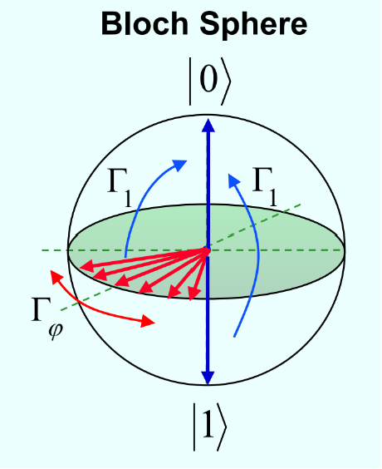
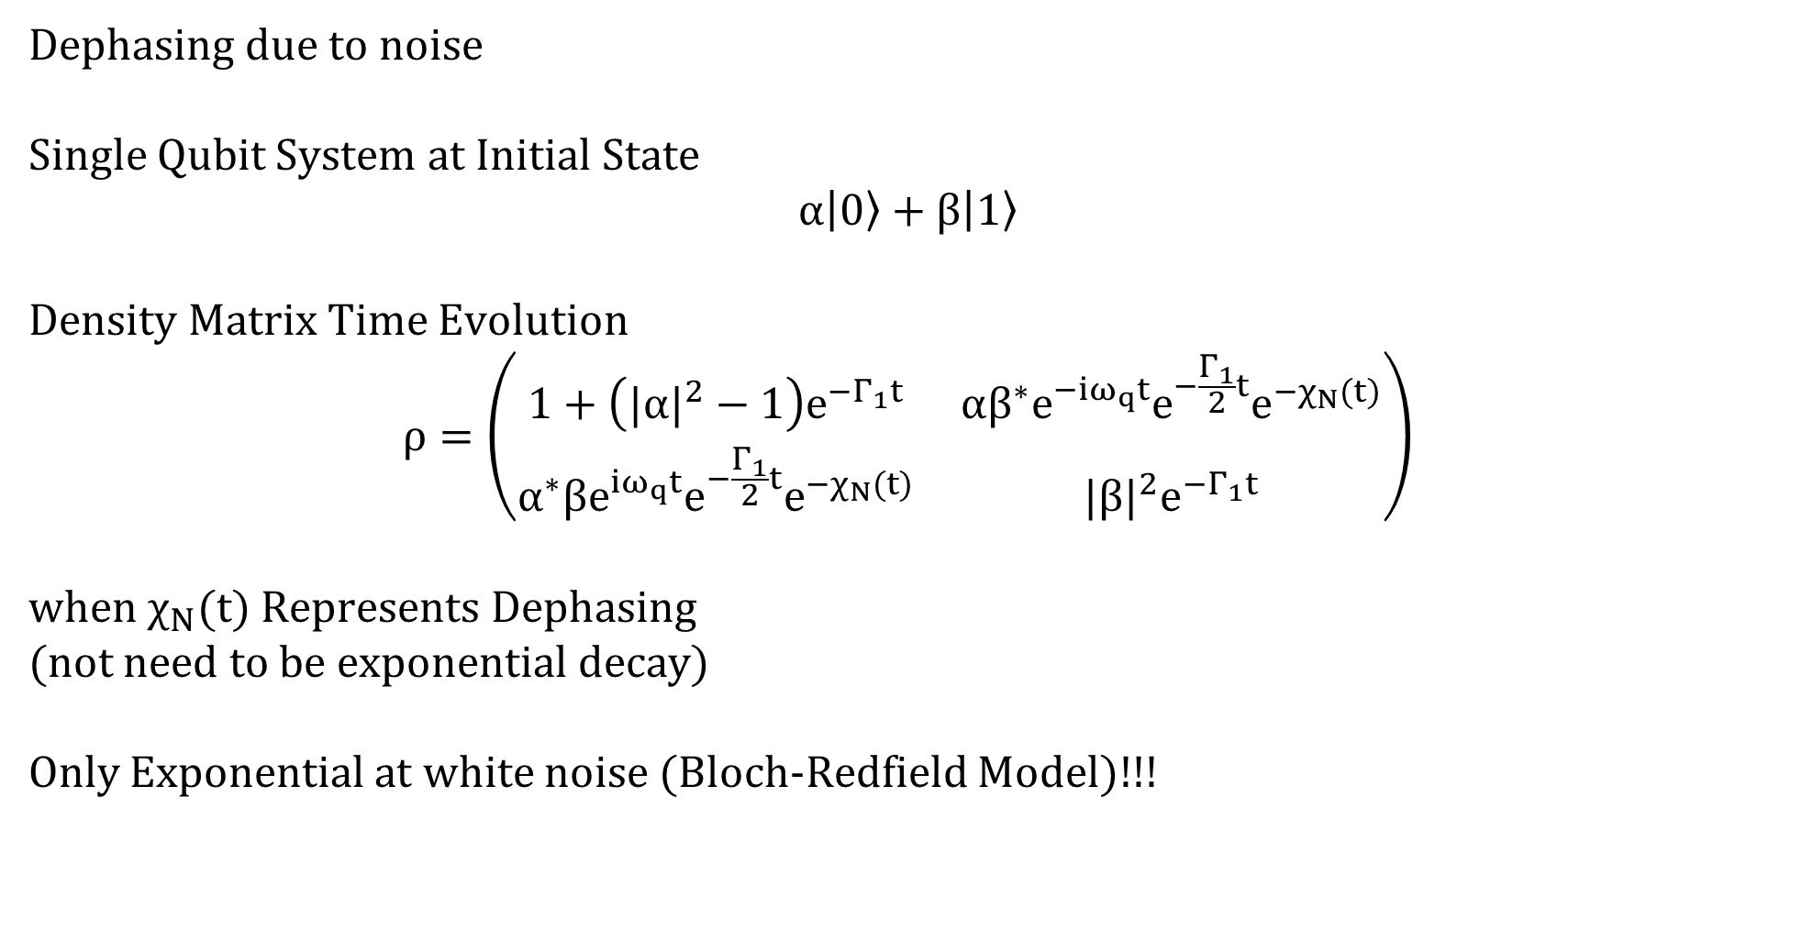
Theory
Dephasing due to noise
Single Qubit System at Initial State
$$α\left|0\right\rangle +β\left|1\right\rangle$$
Density Matrix Time Evolution
$$ρ=\left(\begin{matrix}1+\left({|α|}^{2}−1\right)e^{−Γ_{1}t} & αβ^{∗}e^{−iω_{q}t}e^{−\frac{Γ_{1}}{2}t}e^{−χ_{N}(t)} \\ α^{∗}βe^{iω_{q}t}e^{−\frac{Γ_{1}}{2}t}e^{−χ_{N}(t)} & {|β|}^{2}e^{−Γ_{1}t}\end{matrix}\right)$$
when $χ_{N}(t)$ Represents Dephasing
(not need to be exponential decay)
Only Exponential at white noise (Bloch-Redfield Model)!!!

Slide 5
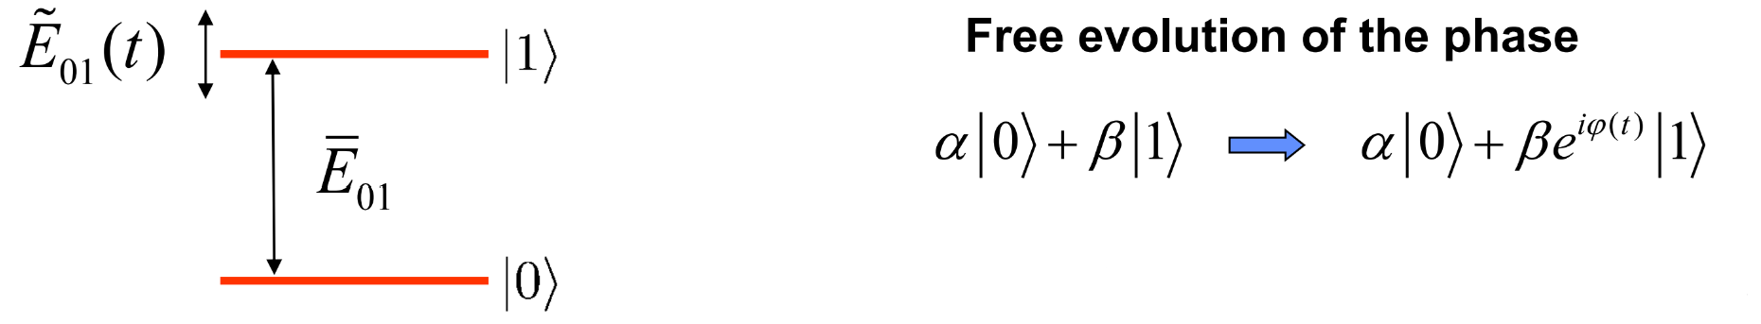
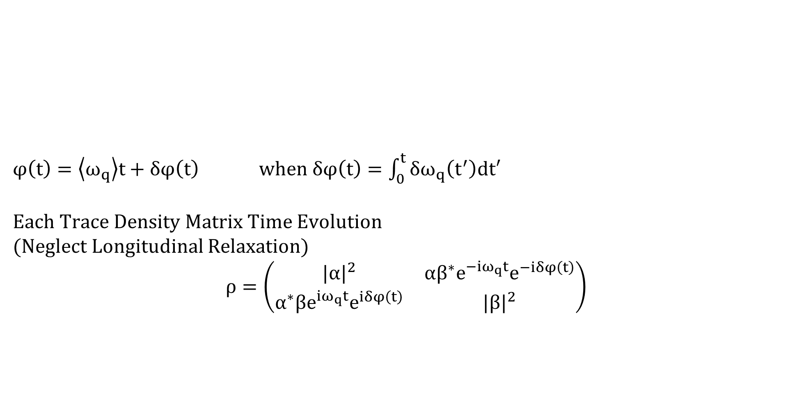
Theory
$φ\left(t\right)=\left\langle ω_{q}\right\rangle t+δφ\left(t\right)$ when $δφ\left(t\right)=\int_{0}^{t}{δω_{q}\left(t^{′}\right)dt′}$
Each Trace Density Matrix Time Evolution
(Neglect Longitudinal Relaxation)
$$ρ=\left(\begin{matrix}{|α|}^{2} & αβ^{∗}e^{−iω_{q}t}e^{−iδφ\left(t\right)} \\ α^{∗}βe^{iω_{q}t}e^{iδφ\left(t\right)} & {|β|}^{2}\end{matrix}\right)$$

Slide 6
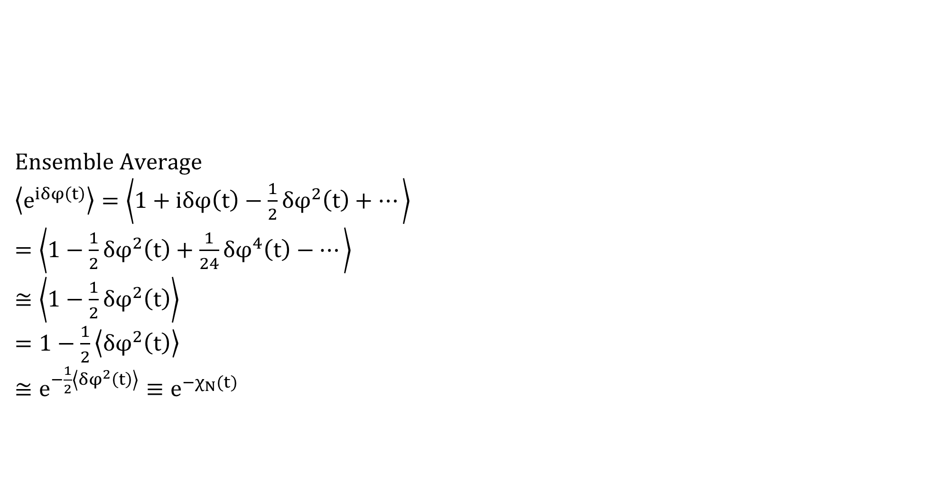
Theory
Ensemble Average
$\left\langle e^{iδφ\left(t\right)}\right\rangle =\left\langle 1+iδφ\left(t\right)−\frac{1}{2}δφ^{2}\left(t\right)+⋯\right\rangle$
$=\left\langle 1−\frac{1}{2}δφ^{2}\left(t\right)+\frac{1}{24}δφ^{4}\left(t\right)−⋯\right\rangle$
$≅\left\langle 1−\frac{1}{2}δφ^{2}\left(t\right)\right\rangle$
$=1−\frac{1}{2}\left\langle δφ^{2}\left(t\right)\right\rangle$
$≅e^{−\frac{1}{2}\left\langle δφ^{2}\left(t\right)\right\rangle }≡e^{−χ_{N}(t)}$

Slide 7
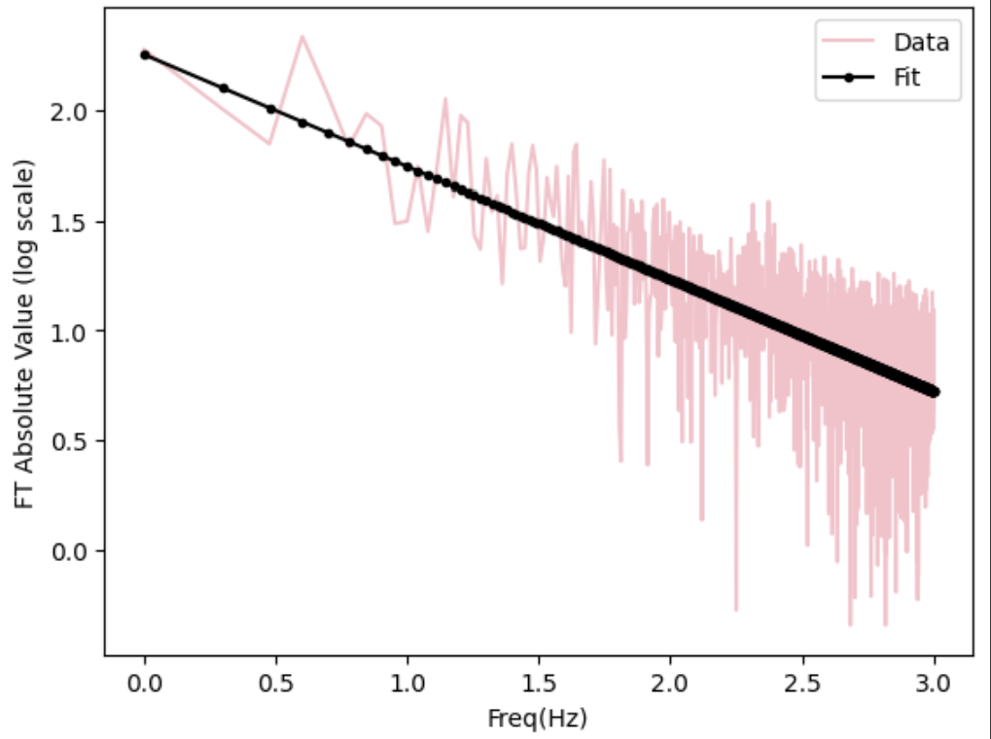
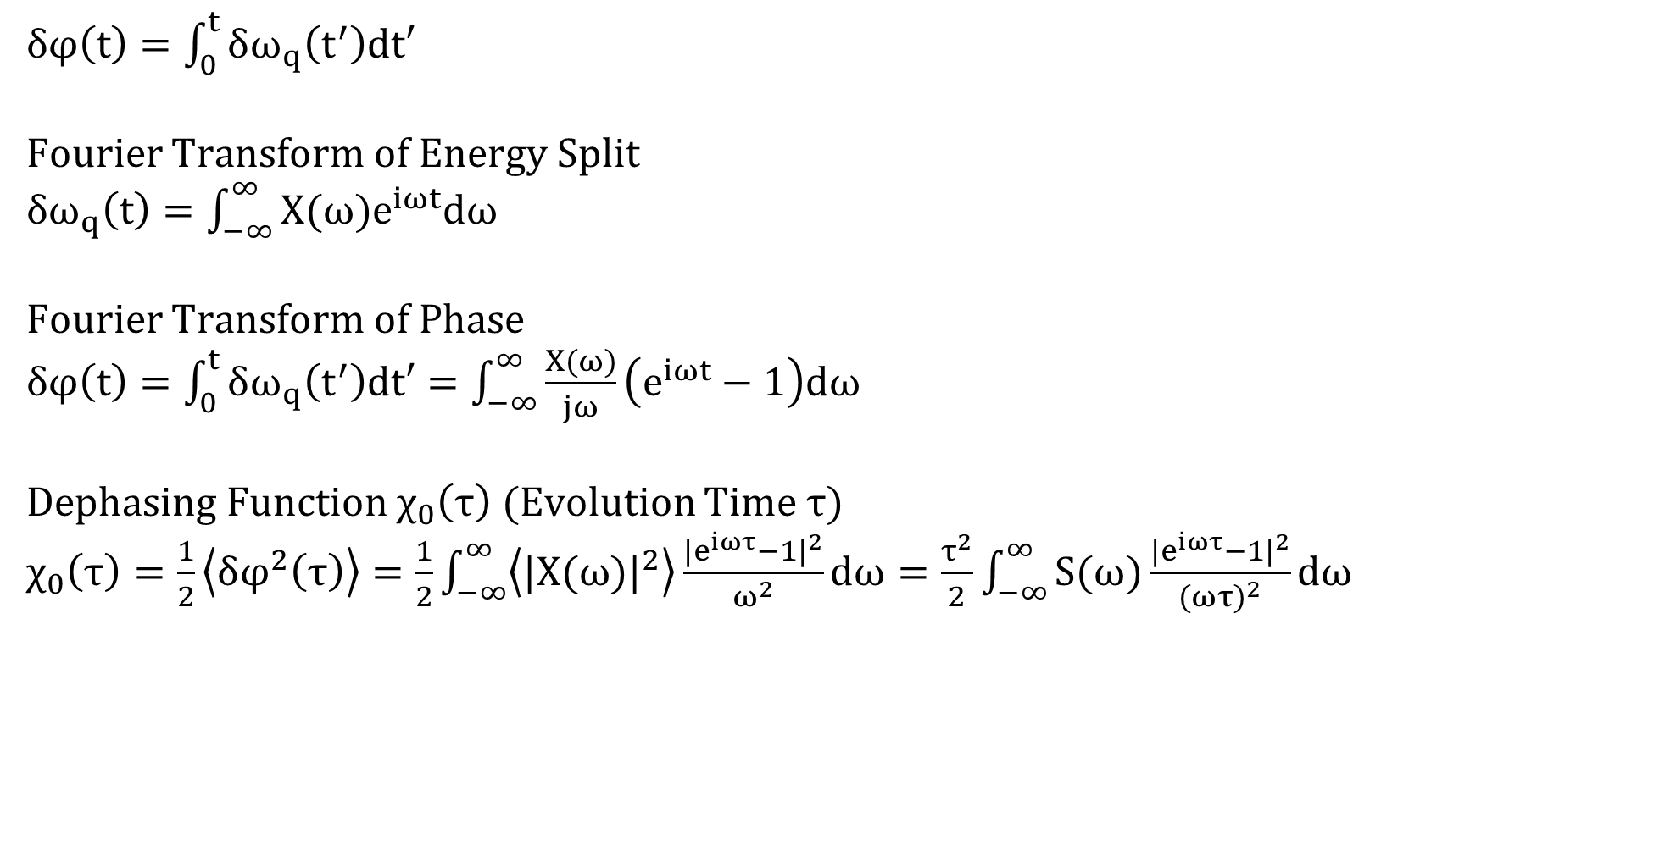
Theory
$δφ\left(t\right)=\int_{0}^{t}{δω_{q}\left(t^{′}\right)dt′}$
Fourier Transform of Energy Split
$δω_{q}\left(t\right)=\int_{−∞}^{∞}{X(ω)e^{iωt}dω}$
Fourier Transform of Phase
$δφ\left(t\right)=\int_{0}^{t}{δω_{q}\left(t^{′}\right)dt′}=\int_{−∞}^{∞}{\frac{X(ω)}{jω}\left(e^{iωt}−1\right)dω}$
Dephasing Function $χ_{0}\left(τ\right)$ (Evolution Time $τ$)
$χ_{0}\left(τ\right)=\frac{1}{2}\left\langle δφ^{2}\left(τ\right)\right\rangle =\frac{1}{2}\int_{−∞}^{∞}{\left\langle {|X(ω)|}^{2}\right\rangle \frac{{|e^{iωτ}−1|}^{2}}{ω^{2}}dω}=\frac{τ^{2}}{2}\int_{−∞}^{∞}{S(ω)\frac{{|e^{iωτ}−1|}^{2}}{{(ωτ)}^{2}}dω}$

Slide 8
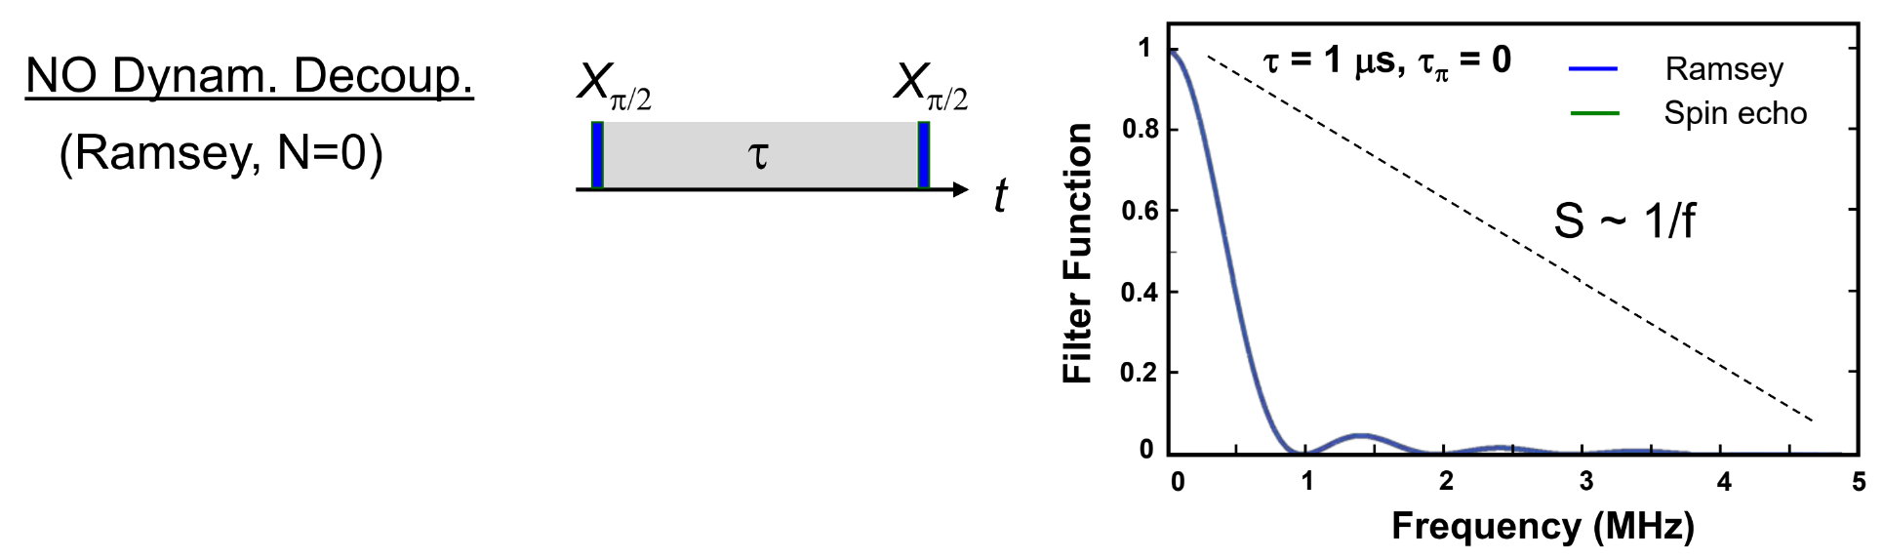
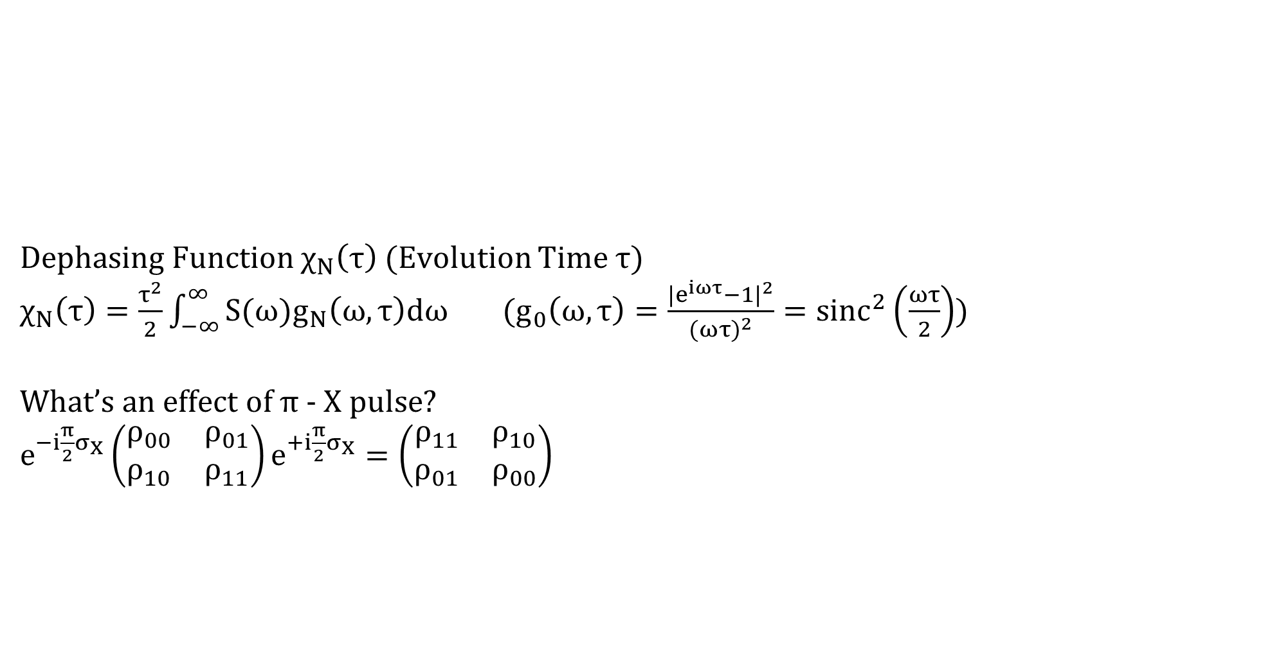
Theory
Dephasing Function $χ_{N}\left(τ\right)$ (Evolution Time $τ$)
$χ_{N}\left(τ\right)=\frac{τ^{2}}{2}\int_{−∞}^{∞}{S(ω)g_{N}\left(ω,τ\right)dω}$ ($g_{0}\left(ω,τ\right)=\frac{{|e^{iωτ}−1|}^{2}}{{(ωτ)}^{2}}={sinc}^{2}\left(\frac{ωτ}{2}\right)$)
What’s an effect of $π$ - X pulse?
$e^{−i\frac{π}{2}σ_{X}}\left(\begin{matrix}ρ_{00} & ρ_{01} \\ ρ_{10} & ρ_{11}\end{matrix}\right)e^{+i\frac{π}{2}σ_{X}}=\left(\begin{matrix}ρ_{11} & ρ_{10} \\ ρ_{01} & ρ_{00}\end{matrix}\right)$

Slide 9
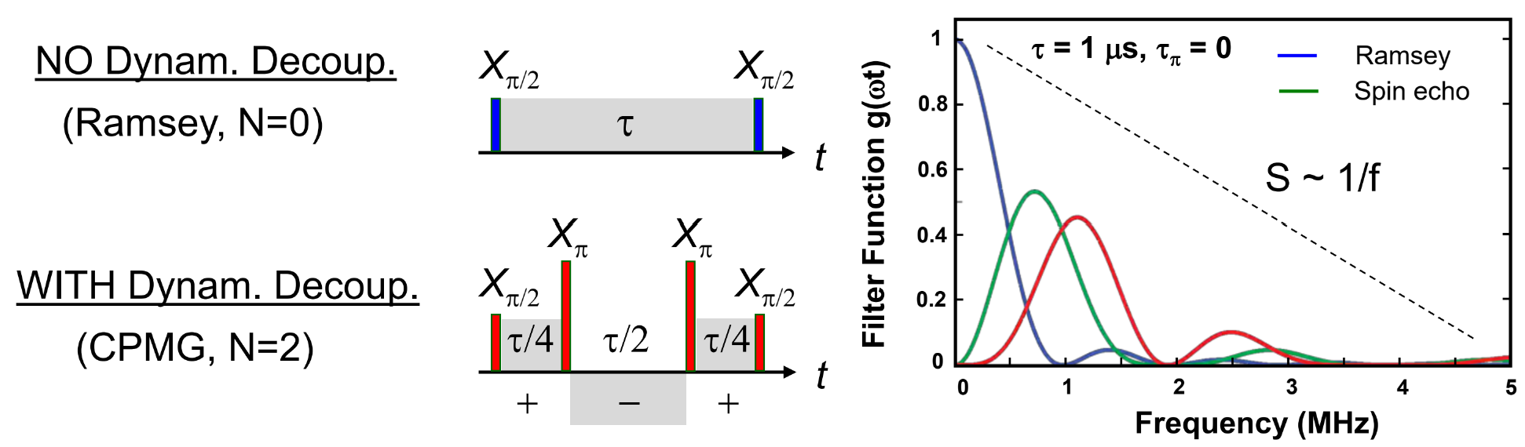
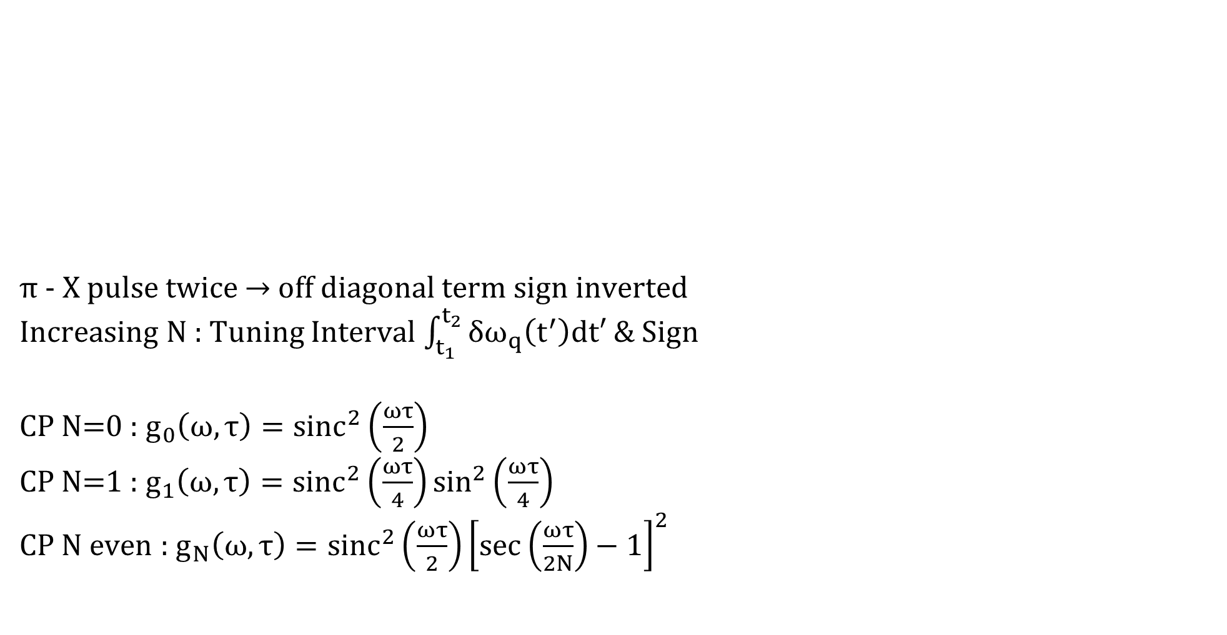
Theory
$π$ - X pulse twice $→$ off diagonal term sign inverted
Increasing N : Tuning Interval $\int_{t_{1}}^{t_{2}}{δω_{q}\left(t^{′}\right)dt′}$ & Sign
CP N=0 : $g_{0}\left(ω,τ\right)={sinc}^{2}\left(\frac{ωτ}{2}\right)$
CP N=1 : $g_{1}\left(ω,τ\right)={sinc}^{2}\left(\frac{ωτ}{4}\right)\sin^{2}\left(\frac{ωτ}{4}\right)$
CP N even : $g_{N}\left(ω,τ\right)={sinc}^{2}\left(\frac{ωτ}{2}\right){\left[\sec\left(\frac{ωτ}{2N}\right)−1\right]}^{2}$

Slide 10
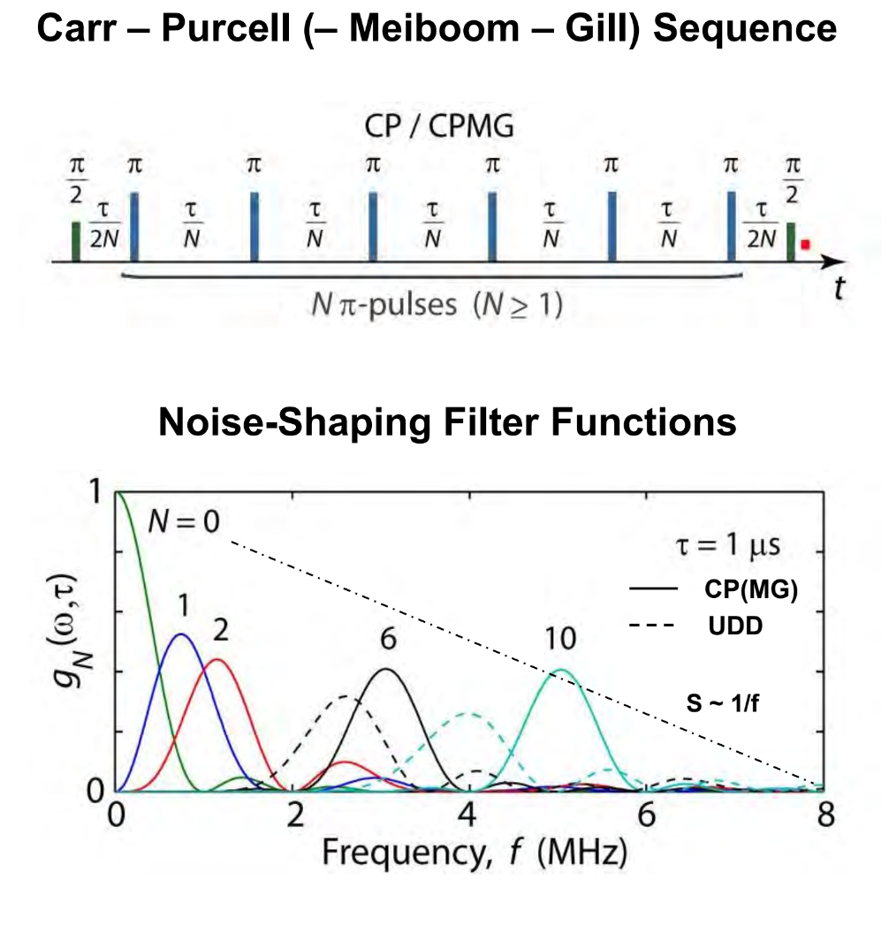
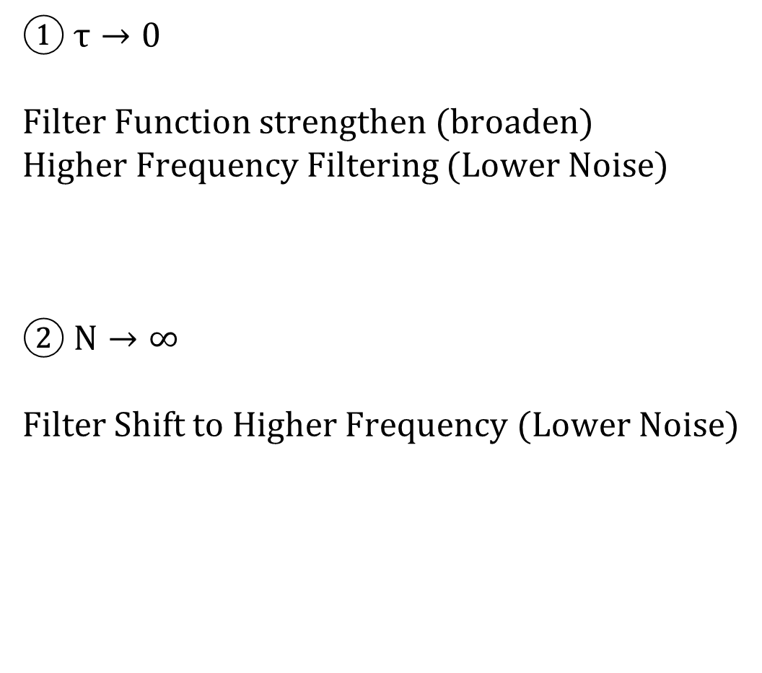
Theory
① $τ→0$
Filter Function strengthen (broaden)
Higher Frequency Filtering (Lower Noise)
② $N→∞$
Filter Shift to Higher Frequency (Lower Noise)

Slide 11
Plot (DIM)

Slide 12
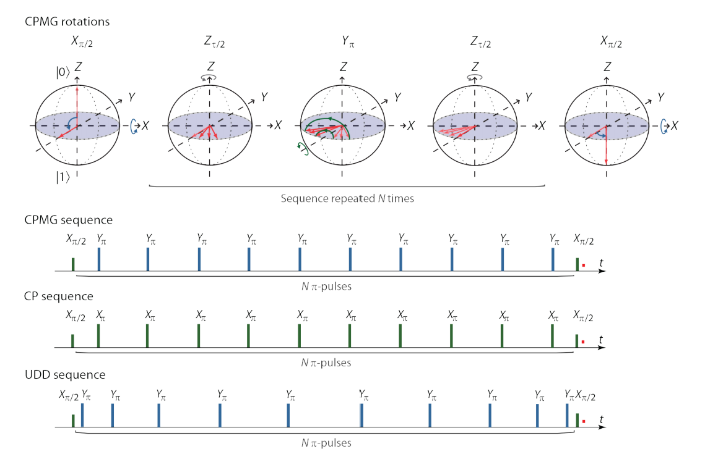
Plot

Slide 13
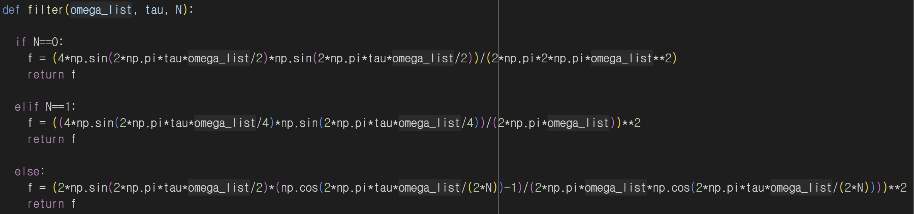
Plot
Noise Filtering Function Plot

Slide 14
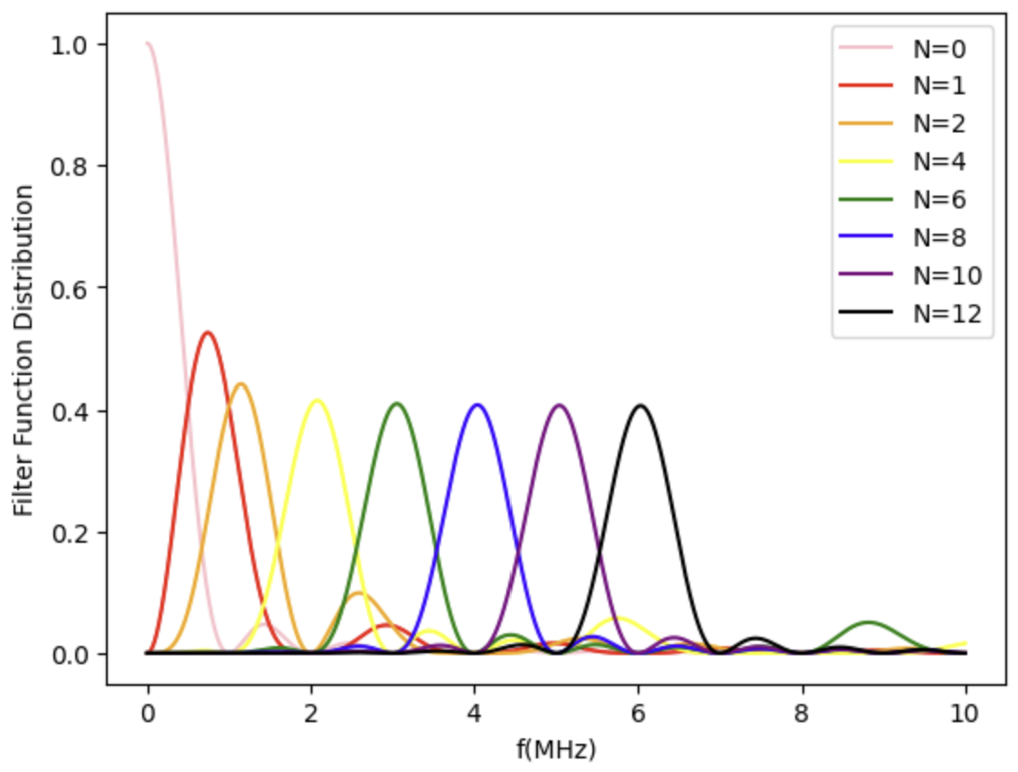
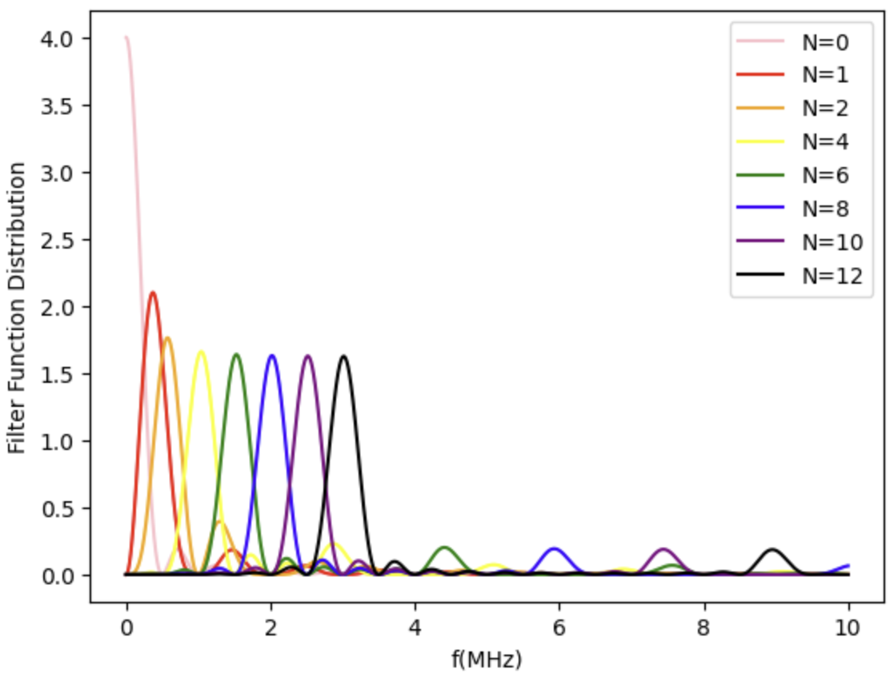
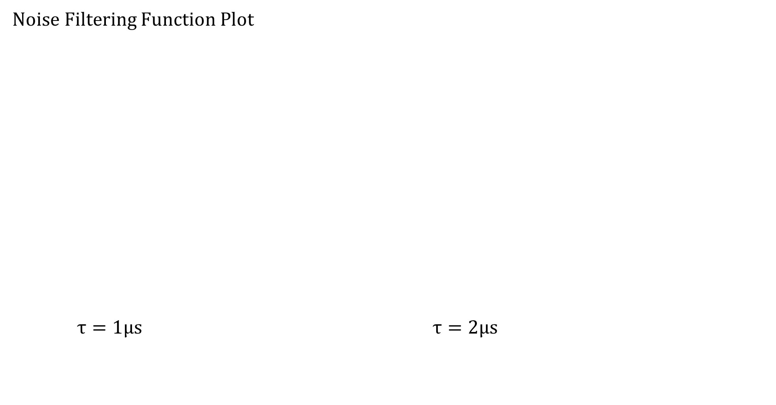
Plot
Noise Filtering Function Plot
$τ=1μs$ $τ=2μs$

Slide 15
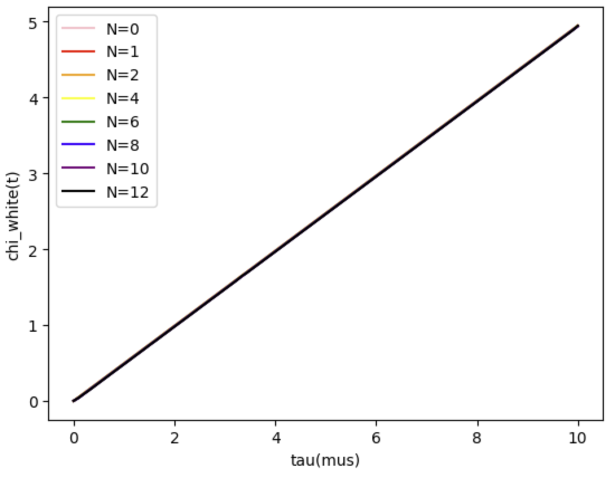
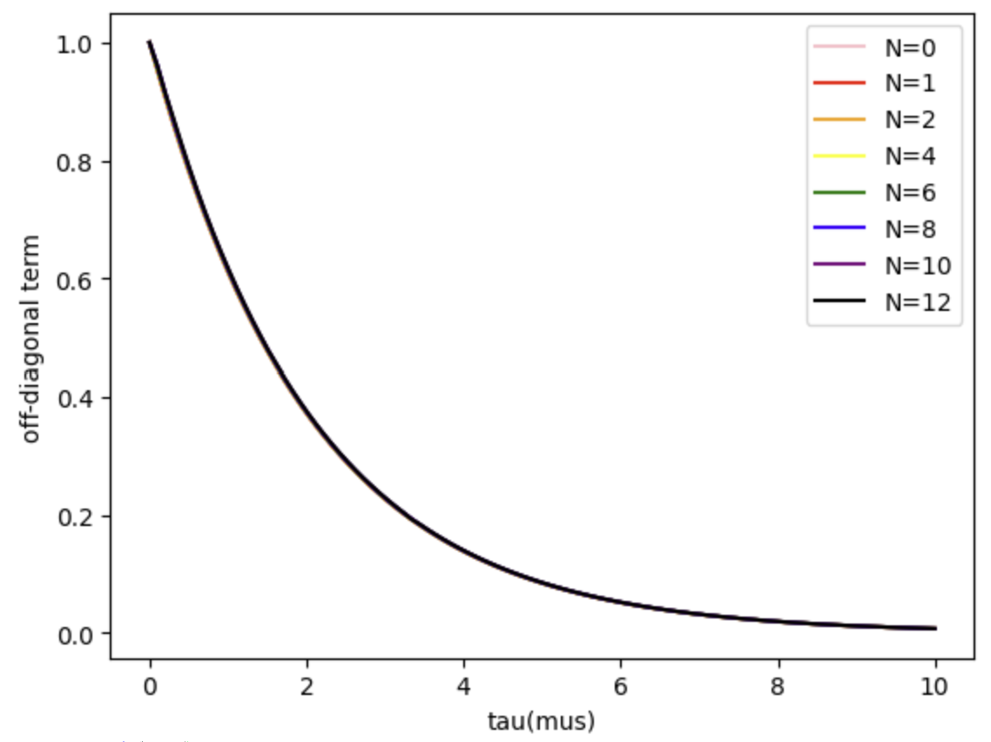
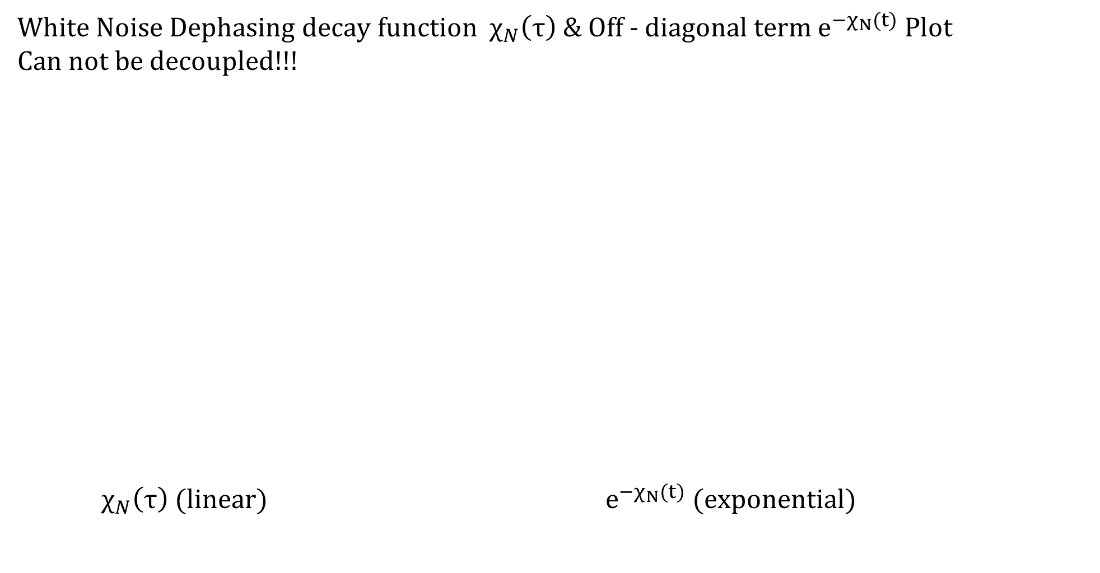
Plot
White Noise Dephasing decay function $χ_{N}\left(τ\right)$ & Off - diagonal term $e^{−χ_{N}(t)}$ Plot
Can not be decoupled!!!
$χ_{N}\left(τ\right)$ (linear) $e^{−χ_{N}(t)}$ (exponential)

Slide 16
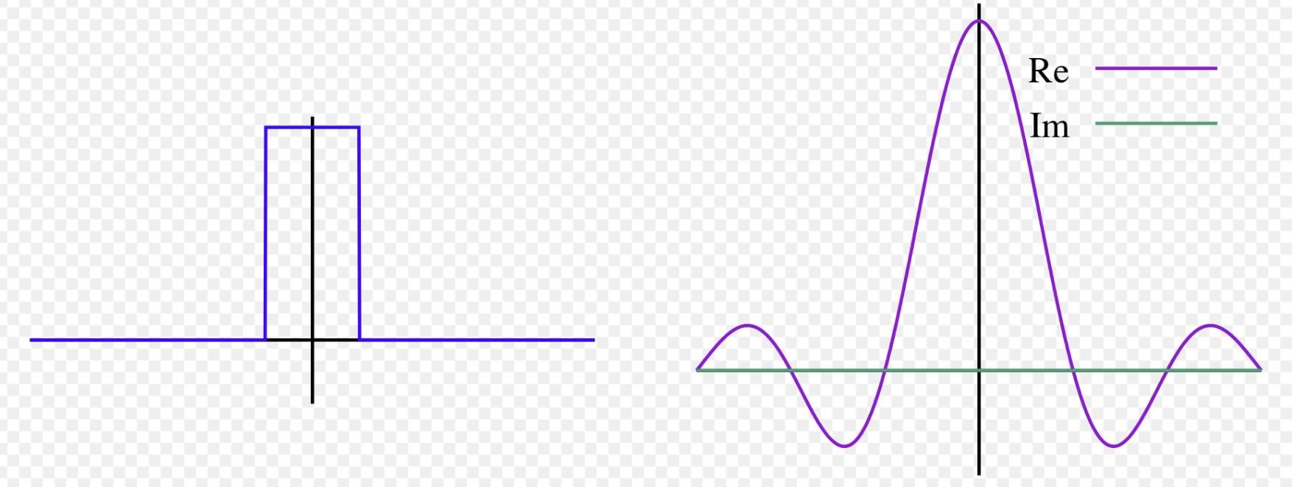
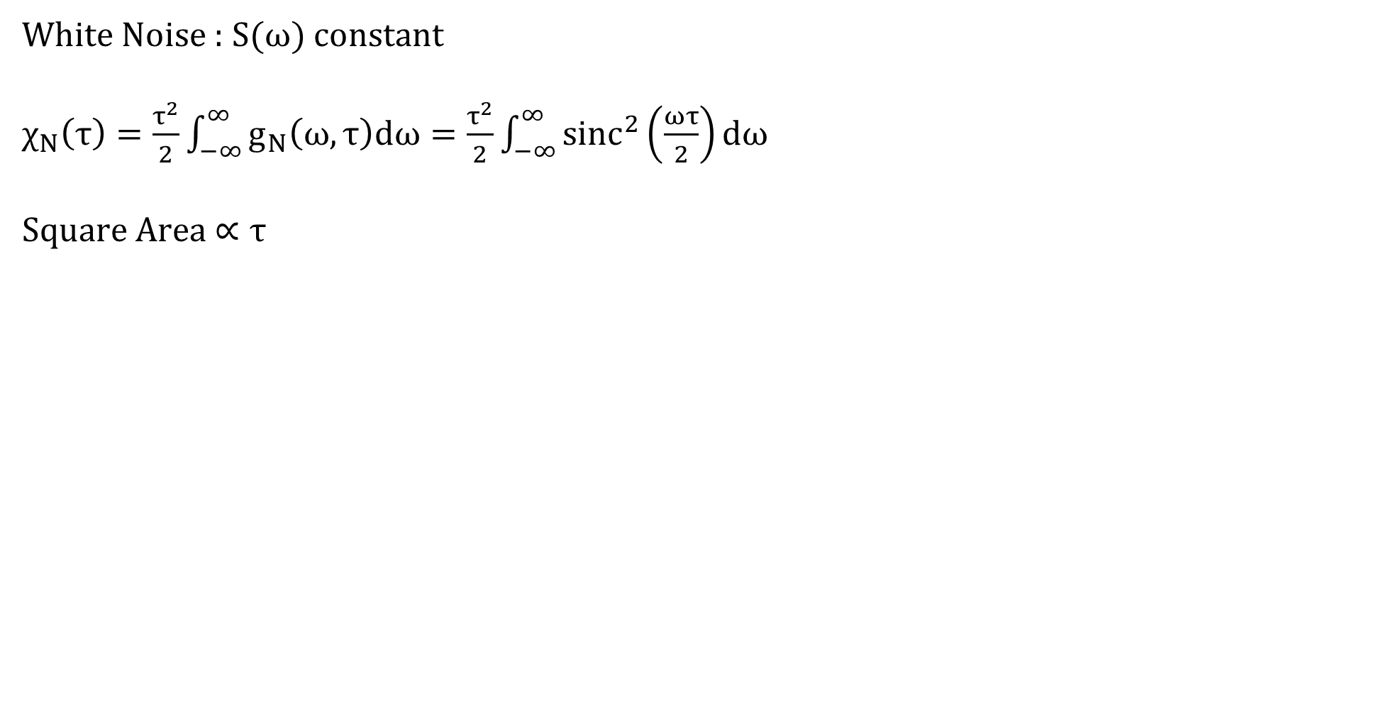
Plot
White Noise : $S(ω)$ constant
$χ_{N}\left(τ\right)=\frac{τ^{2}}{2}\int_{−∞}^{∞}{g_{N}\left(ω,τ\right)dω}=\frac{τ^{2}}{2}\int_{−∞}^{∞}{{sinc}^{2}\left(\frac{ωτ}{2}\right)dω}$
Square Area $∝τ$

Slide 17
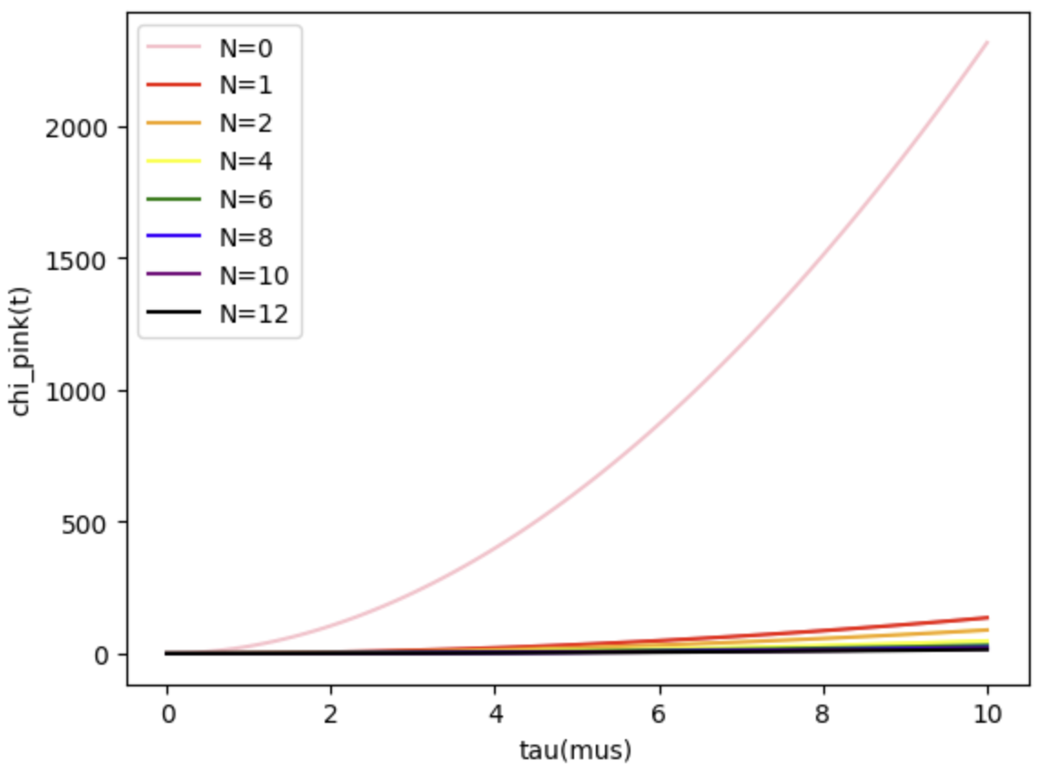
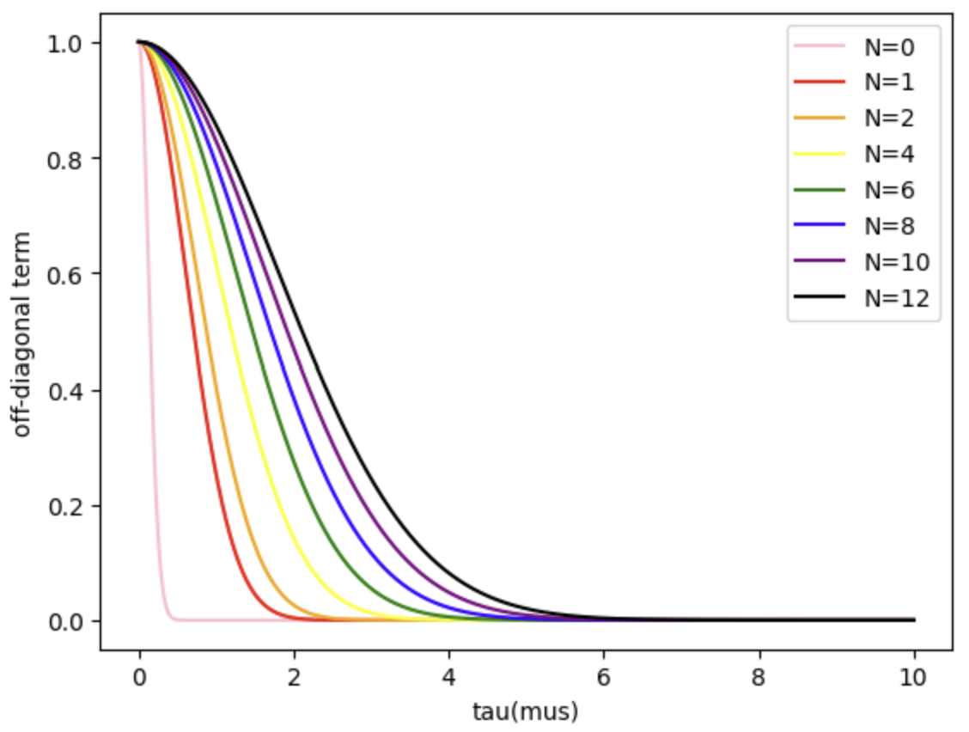
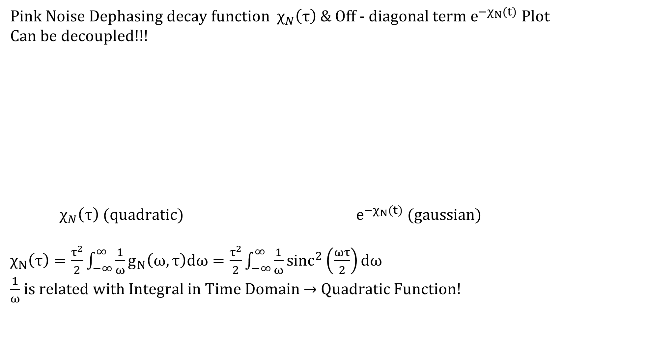
Plot
Pink Noise Dephasing decay function $χ_{N}\left(τ\right)$ & Off - diagonal term $e^{−χ_{N}(t)}$ Plot
Can be decoupled!!!
$χ_{N}\left(τ\right)$ (quadratic) $e^{−χ_{N}(t)}$ (gaussian)
$χ_{N}\left(τ\right)=\frac{τ^{2}}{2}\int_{−∞}^{∞}{\frac{1}{ω}g_{N}\left(ω,τ\right)dω}=\frac{τ^{2}}{2}\int_{−∞}^{∞}{\frac{1}{ω}{sinc}^{2}\left(\frac{ωτ}{2}\right)dω}$
$\frac{1}{ω}$ is related with Integral in Time Domain $→$ Quadratic Function!

Slide 18
1/f Noise Decoupling Simulation
at Rotating Frame

Slide 19
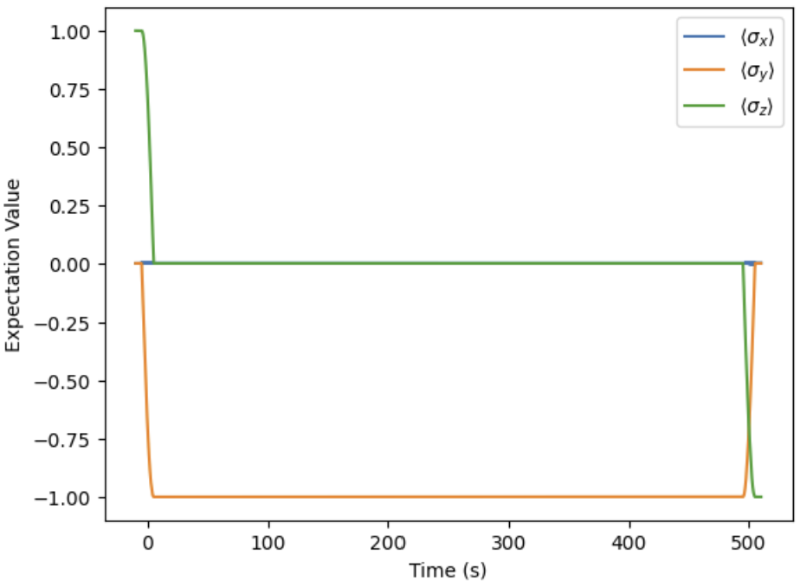
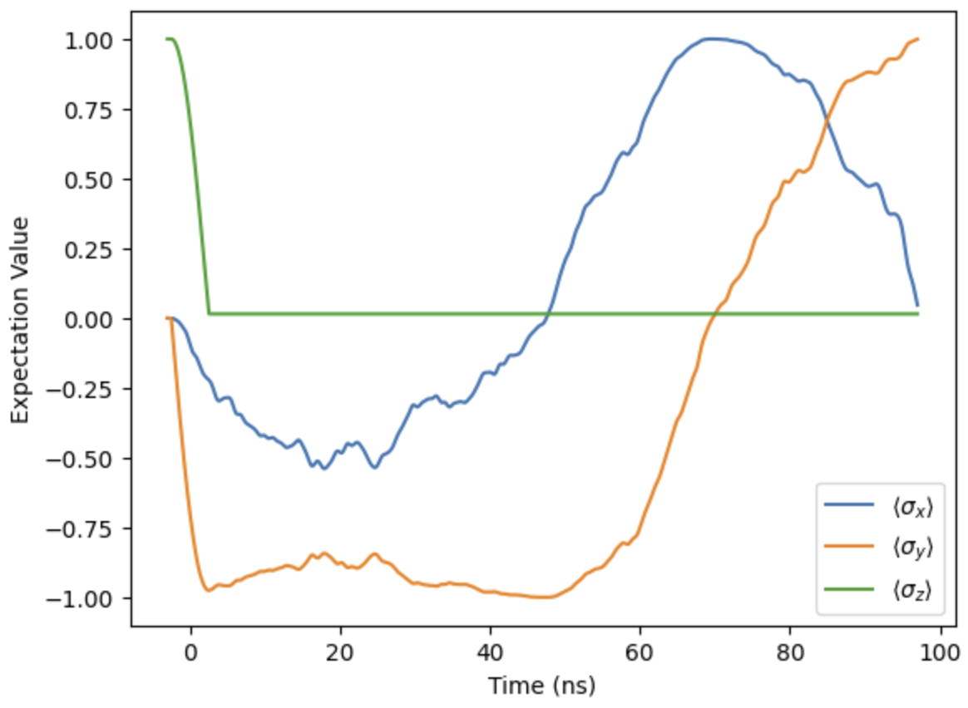
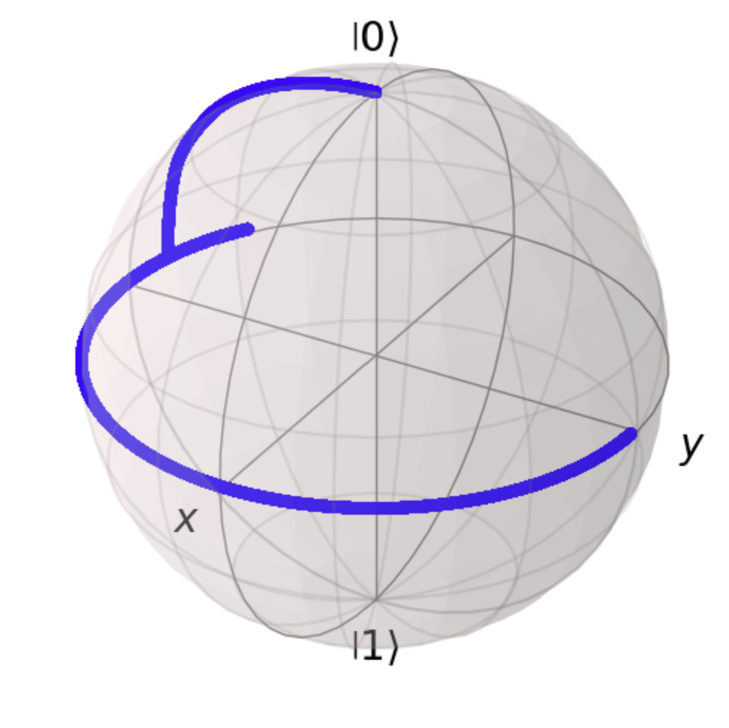
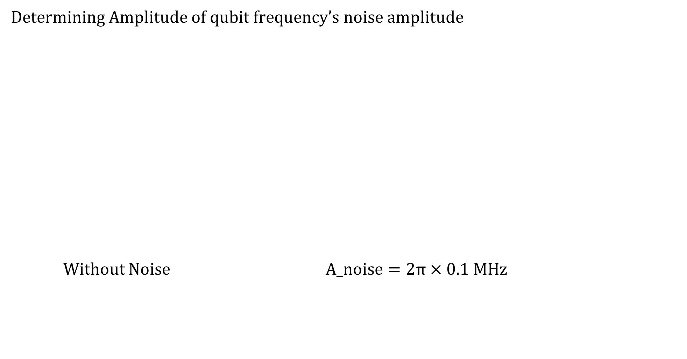
Simulation
Determining Amplitude of qubit frequency’s noise amplitude
Without Noise $A_noise=2π×0.1 MHz$

Slide 20
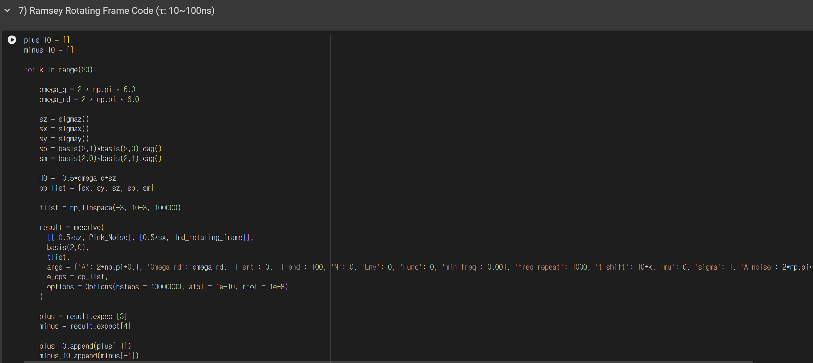
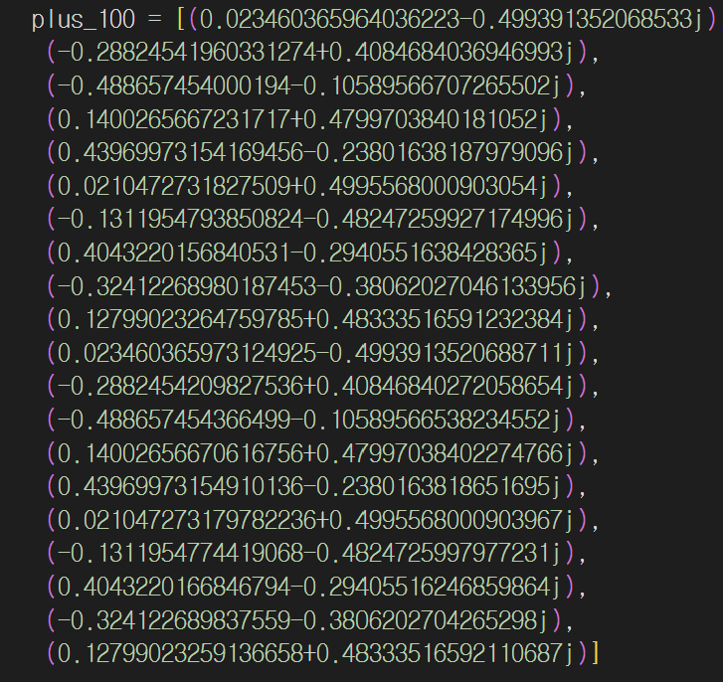
Simulation
Ramsey, Spin Echo, CP (N=2)
For fixed evolution time, calculate ensemble average of off diagonal term
(Because of computation time, only made 20 traces)
Data Example

Slide 21
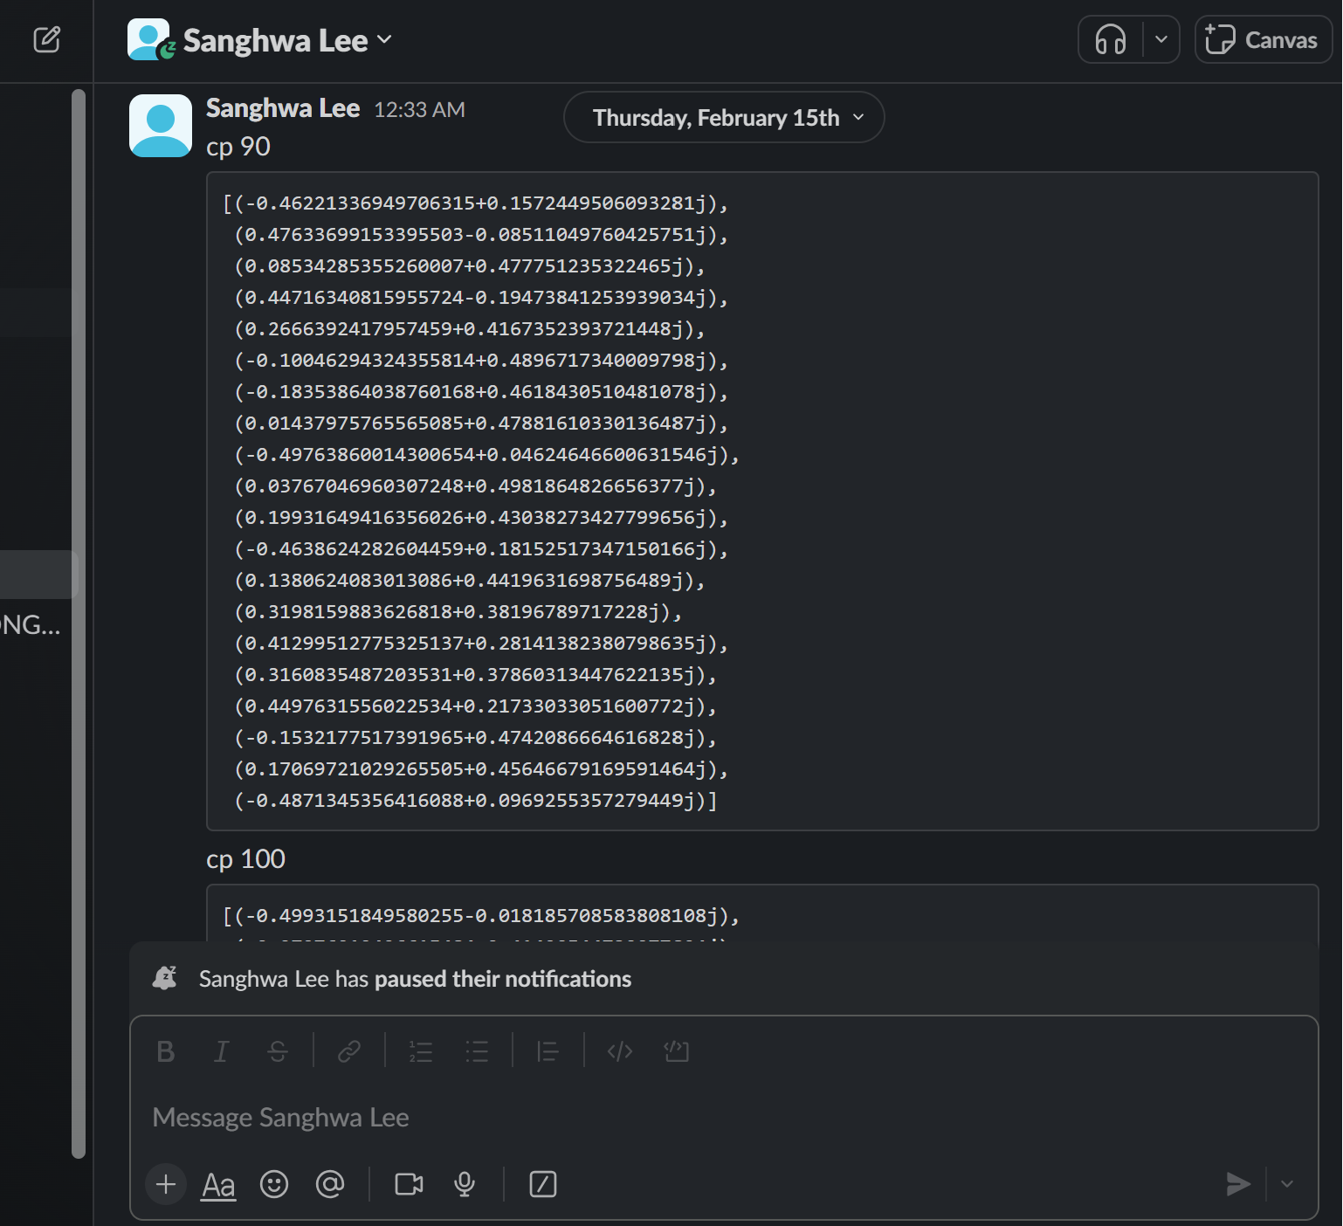
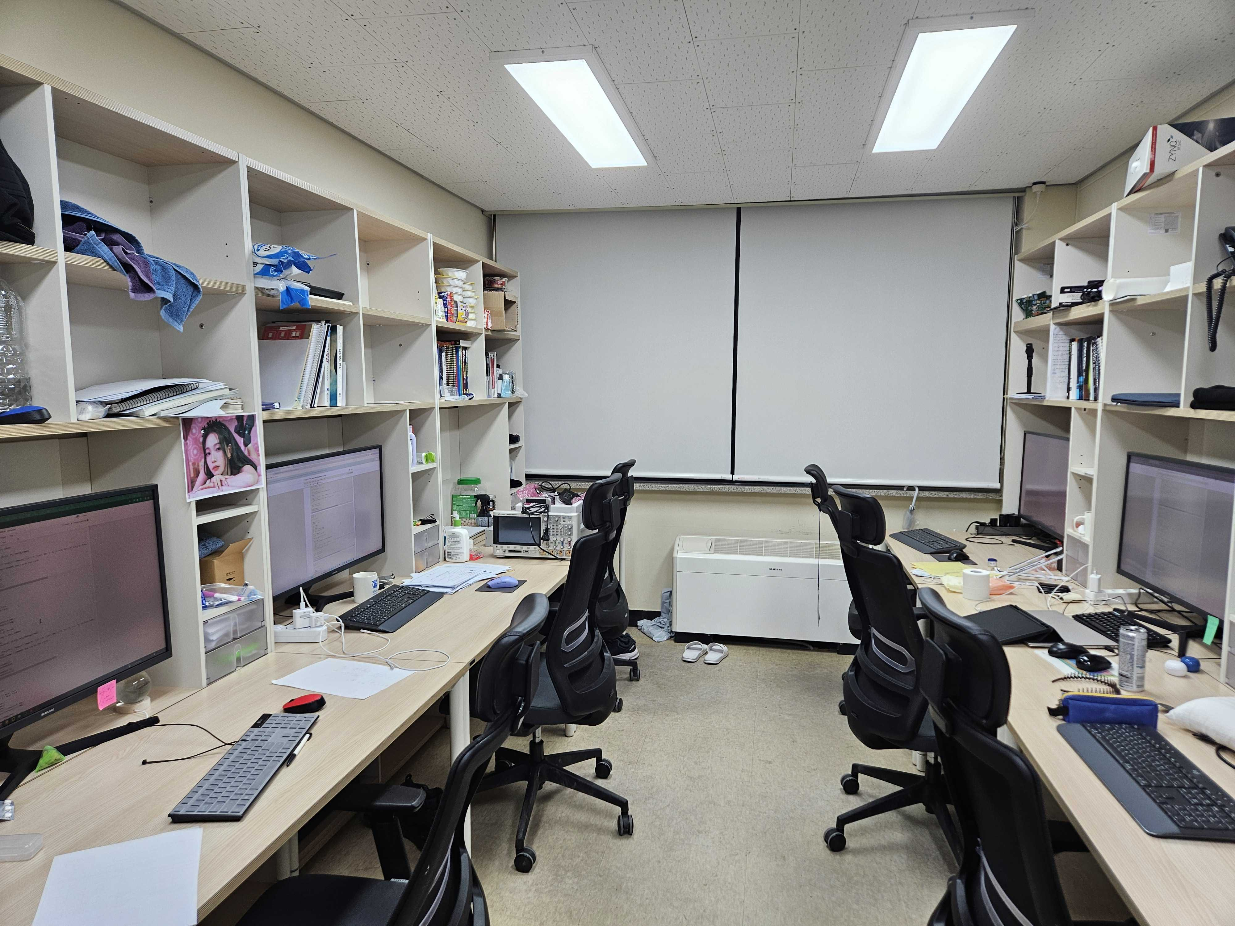
Simulation

Slide 22
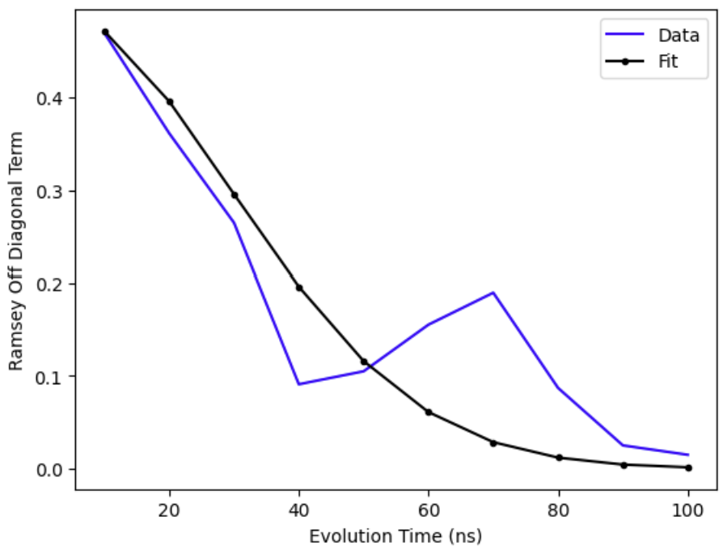
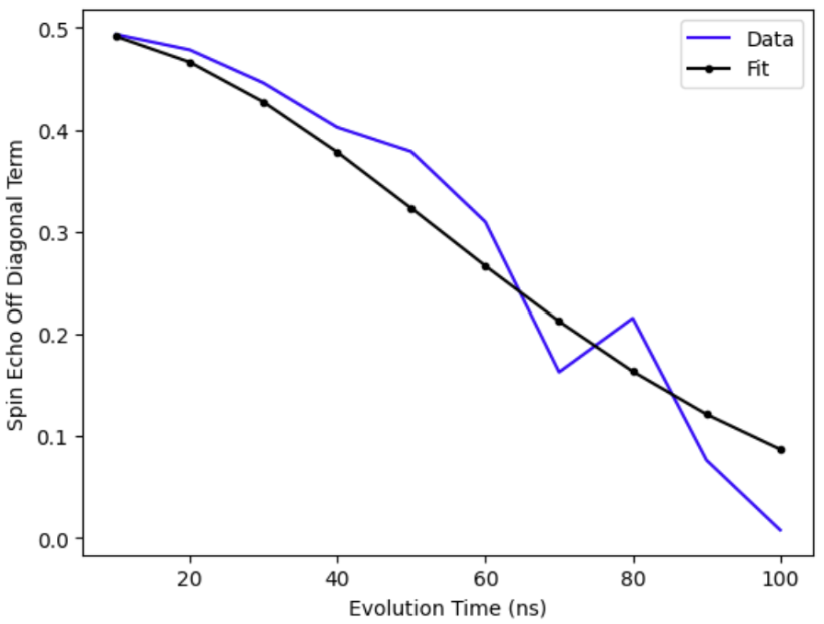
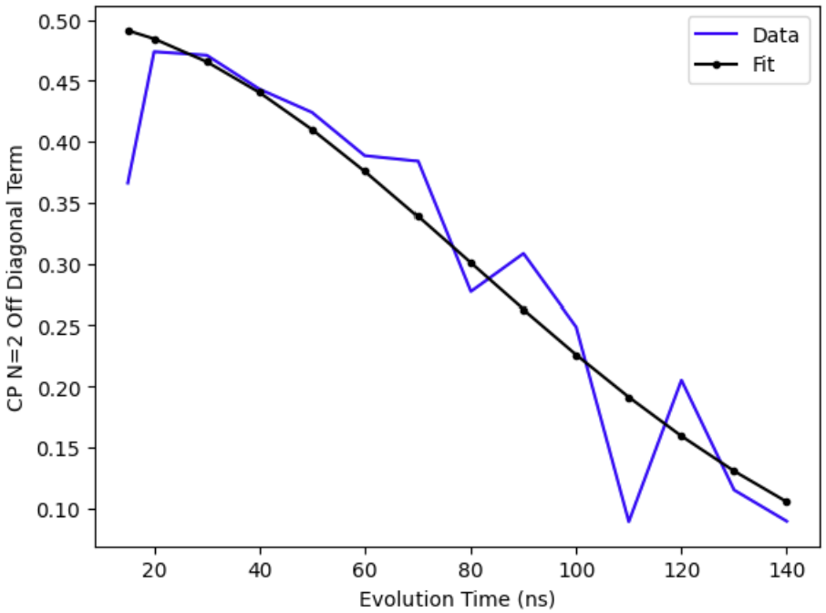
Simulation
Ramsey Spin Echo CP N=2
# of Trace : 20… Because of Computing Time

Slide 23
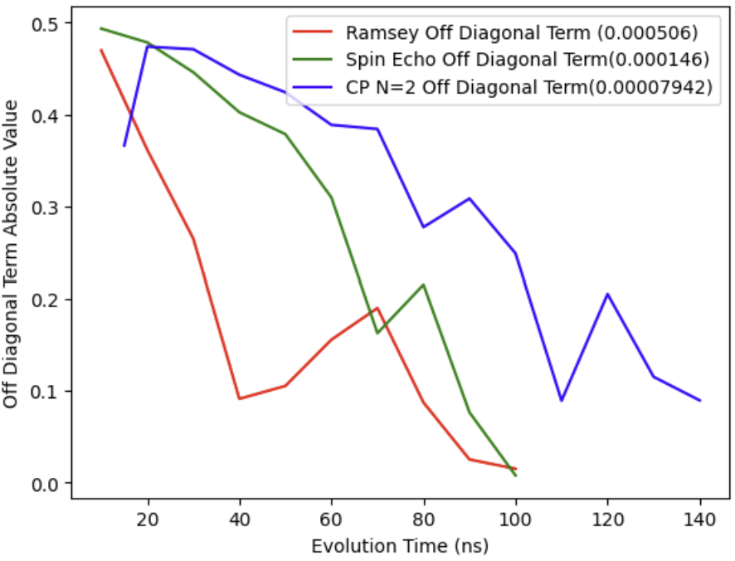
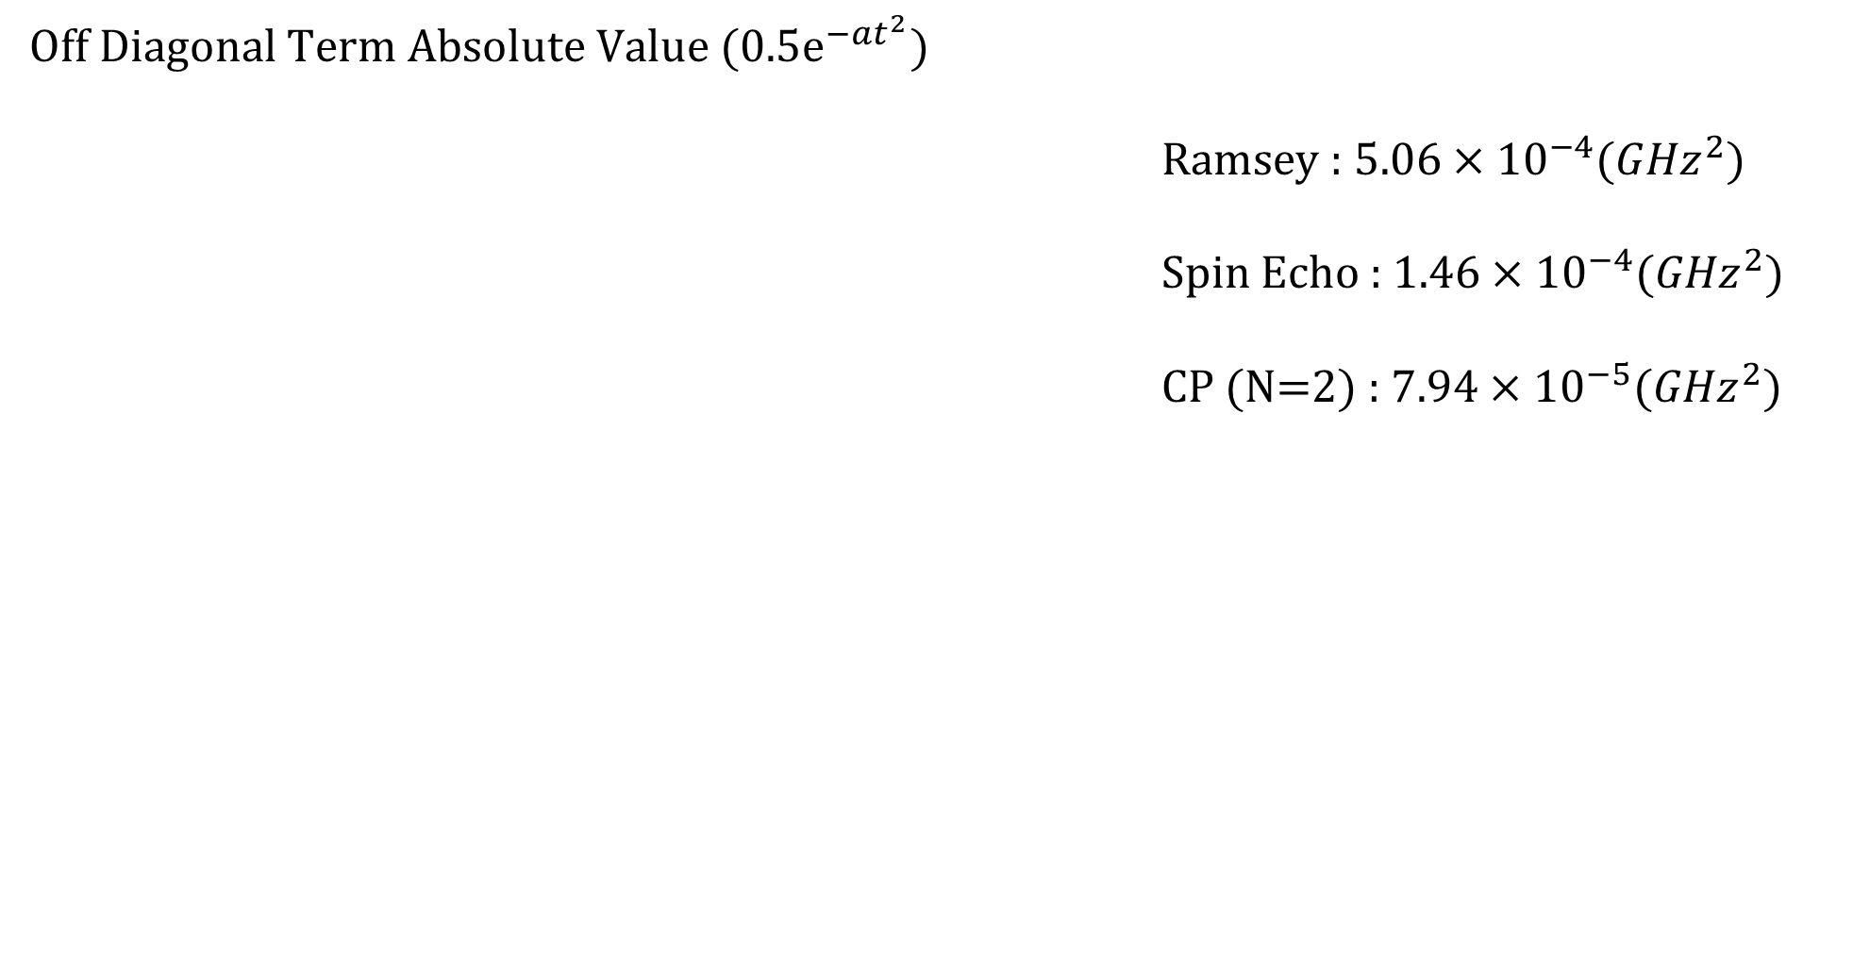
Simulation
Off Diagonal Term Absolute Value (0.5$e^{−at^{2}}$)
Ramsey : $5.06×{10}^{−4}({GHz}^{2})$
Spin Echo : $1.46×{10}^{−4}({GHz}^{2})$
CP (N=2) : $7.94×{10}^{−5}({GHz}^{2})$

Slide 24
Thank you

